Slide 1
Autosar Adaptive modelling using MATLAB Simulink
Sandeep Bhargav & Abhishek Ramesh
E EN CT BSC SFT

Slide 2
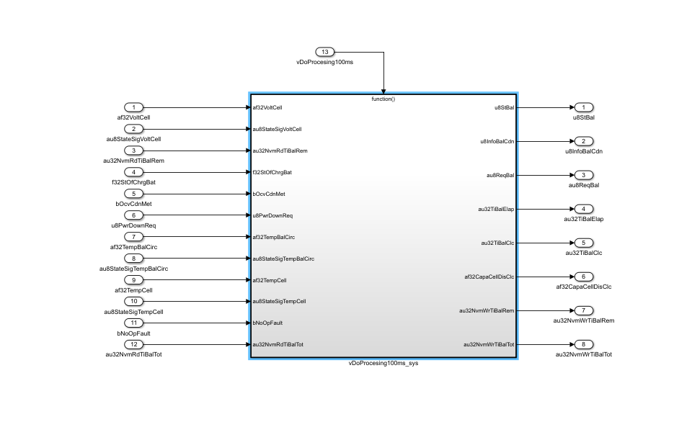
Autosar Adaptive modelling using MATLAB Simulink
Simulink modelling
Prepare the base application function model in advance, or it can be done after defining and importing the service definitions

Slide 3
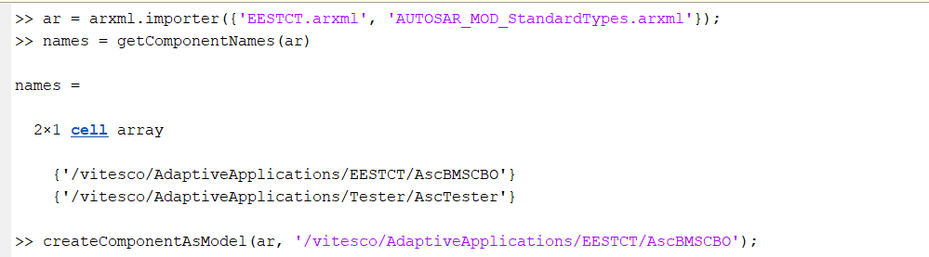
Autosar Adaptive modelling using MATLAB Simulink
Import ARXML files
Import service definitions from Davinci Developer for Adaptive (or any other similar toolset)
Run these commands to import the ARXML files containing the service definitions
Use command “createComponentAs Model” to create a skeleton interfaces from the service definitions imported from ARXML files

Slide 4
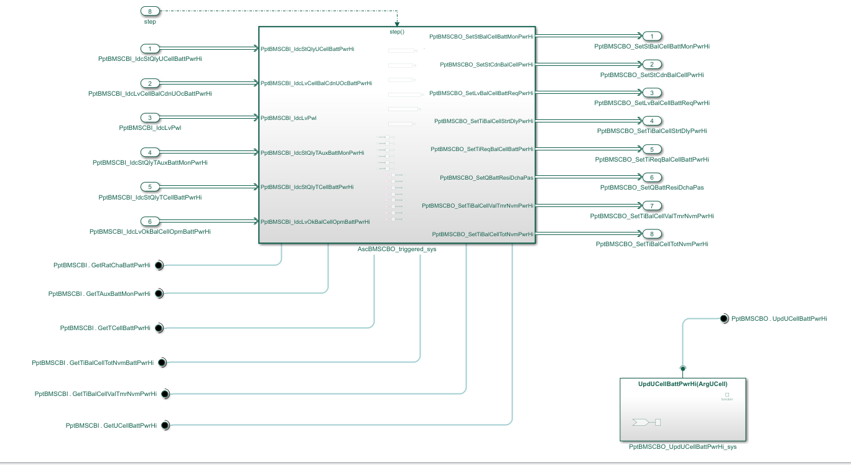
Autosar Adaptive modelling using MATLAB Simulink
Create interface model
The skeleton model generated from arxml files contain the input and output services connected to the ports

Slide 5
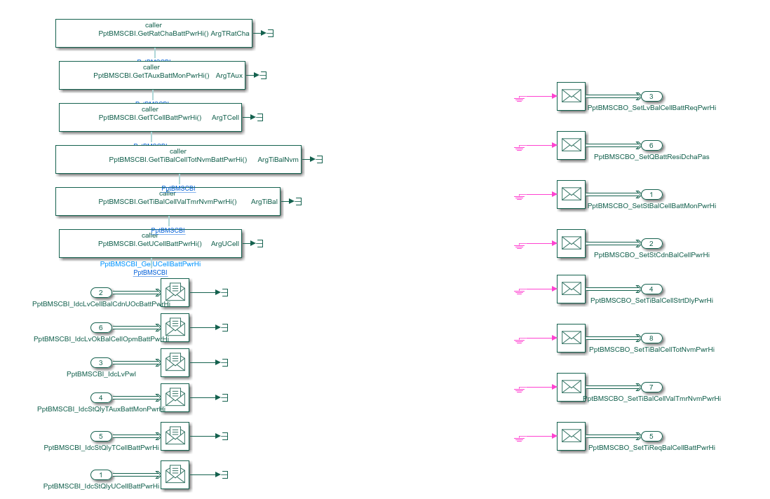
Autosar Adaptive modelling using MATLAB Simulink
Create interface model
The defined services are then connected to event receive, even send and function caller blocks (depending on the types of services).
These blocks convert the services to signals and vice versa, to be processed in the Simulink model
These blocks are grounded and terminated. These are to be connected to the signals to and from the application model

Slide 6
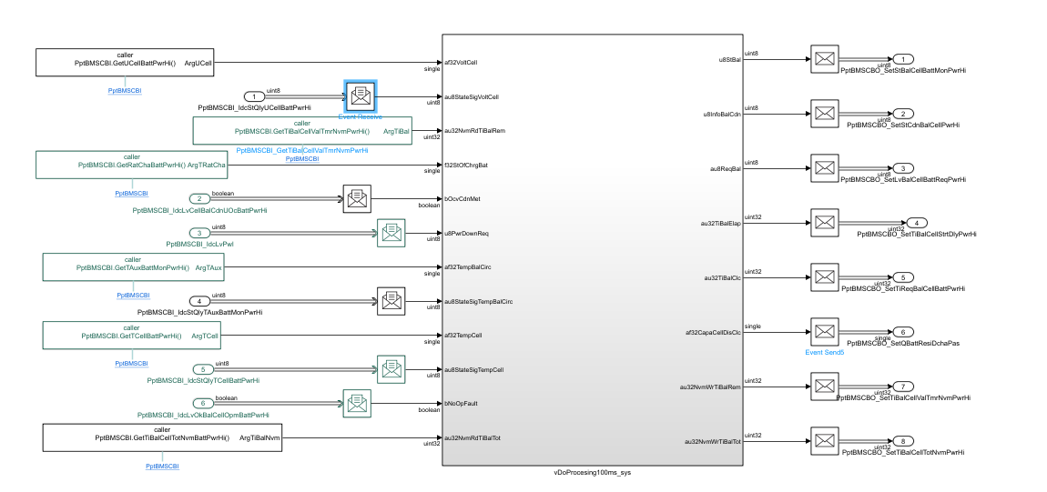
Autosar Adaptive modelling using MATLAB Simulink
Connect application design to interface model
Design the application functionality between the interface skeleton
Connect the event receive and function caller blocks to the input signal ports, and the event send blocks to the output signal ports

Slide 7
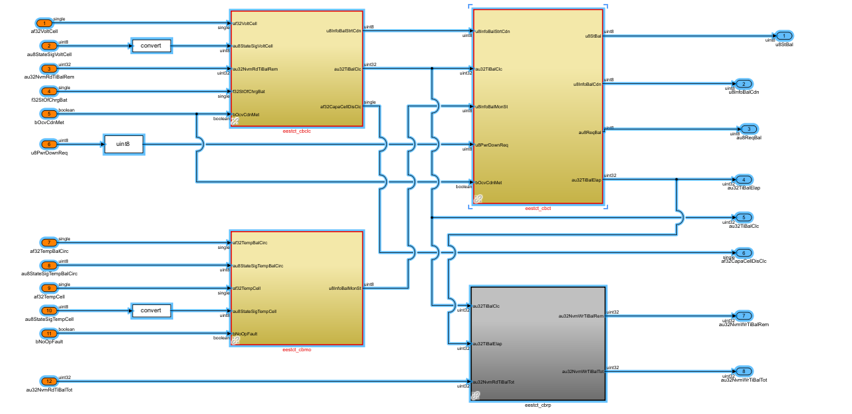
Autosar Adaptive modelling using MATLAB Simulink
Connect application design to interface model
The application model design is similar to any other Simulink model design.
Once the design is completed, make sure the connections are properly established

Slide 8
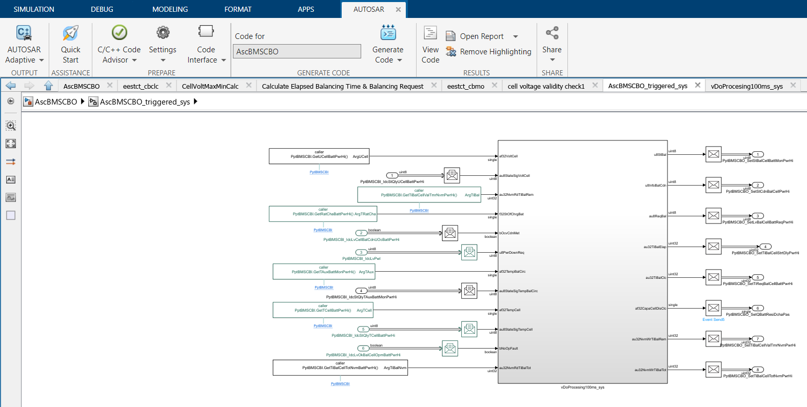
Autosar Adaptive modelling using MATLAB Simulink
Connect application design to interface model
Once the model design is complete, it is ready to be updated to the Adaptive Autosar environment.
Compile the model to make sure there are no compilation errors

Slide 9
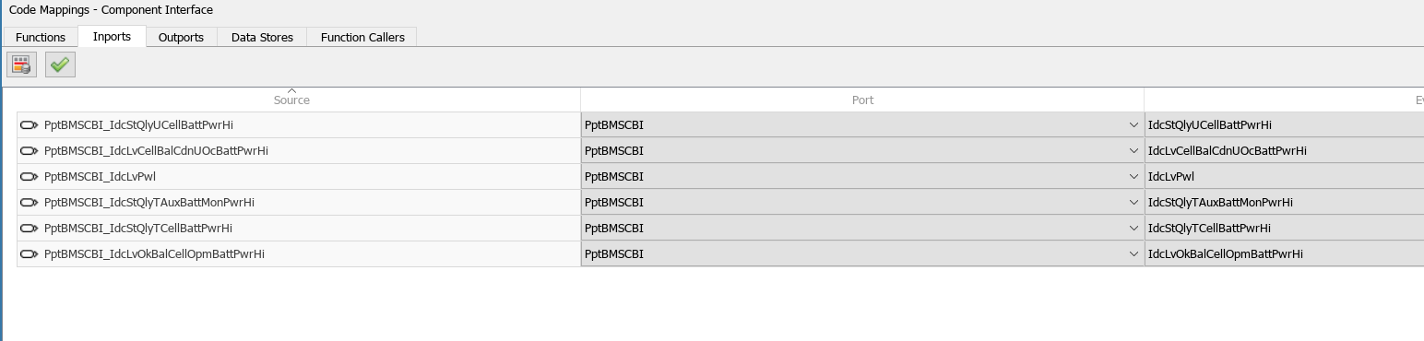
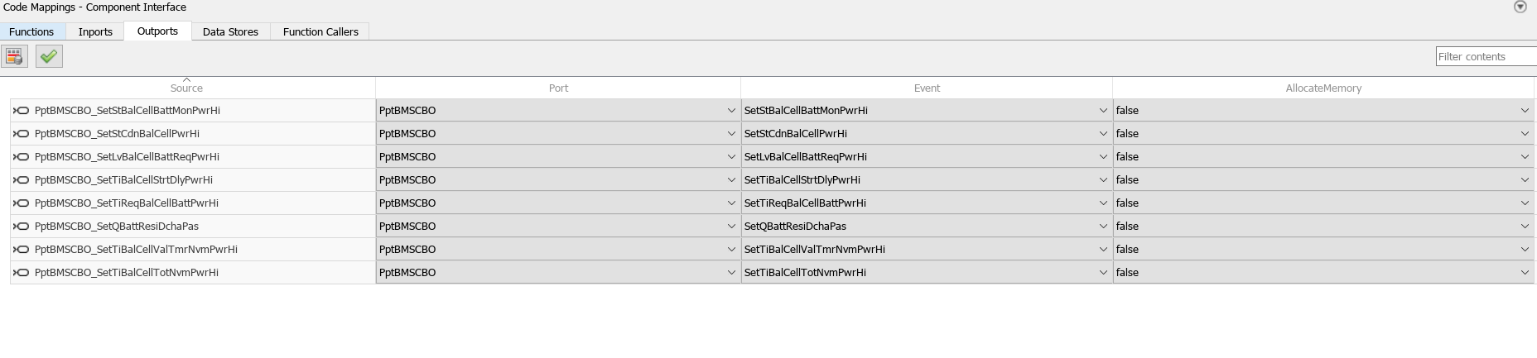
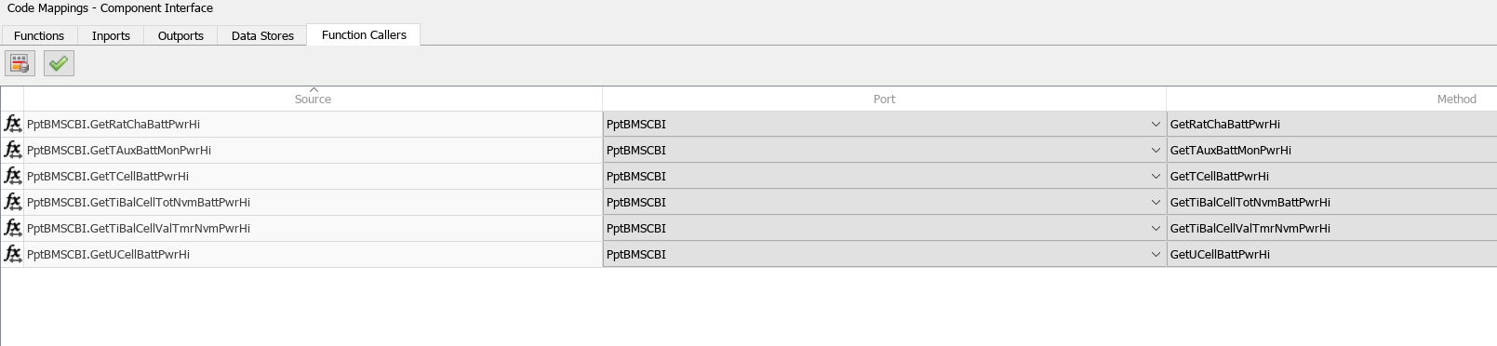
Autosar Adaptive modelling using MATLAB Simulink
Code mappings
Open the code mappings tab, and then establish the code mappings, i.e map the Simulink ports to the corresponding Adaptive Autosar ports for Inports, Outports and Function callers

Slide 10
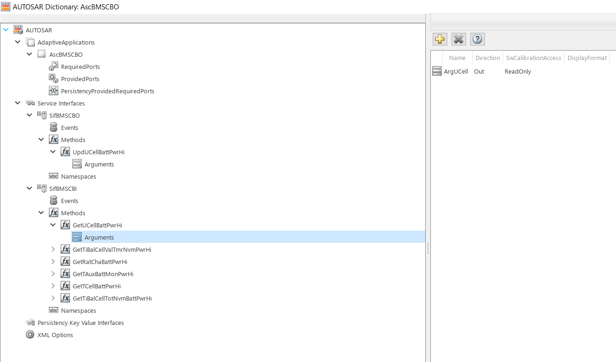
Autosar Adaptive modelling using MATLAB Simulink
Autosar dictionary
Once the code mappings are done, open Autosar Dictionary
In the dictionary, Define the input and output ports
Define the arguments name and directions
Define the namespaces

Slide 11
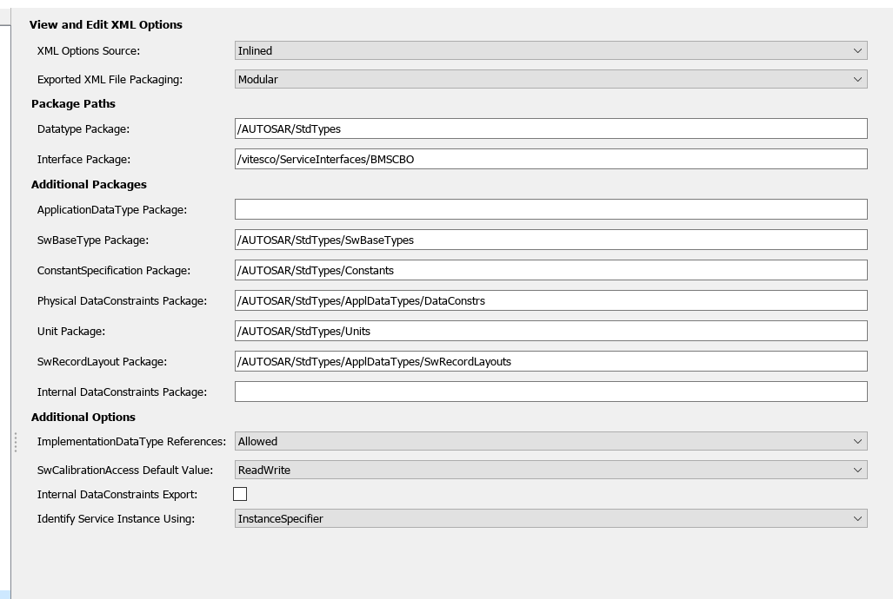
Autosar Adaptive modelling using MATLAB Simulink
Xml options
Set the xml options based on preference
The application packages can be defined individually as shown, or can be combined into one single arxml file

Slide 12
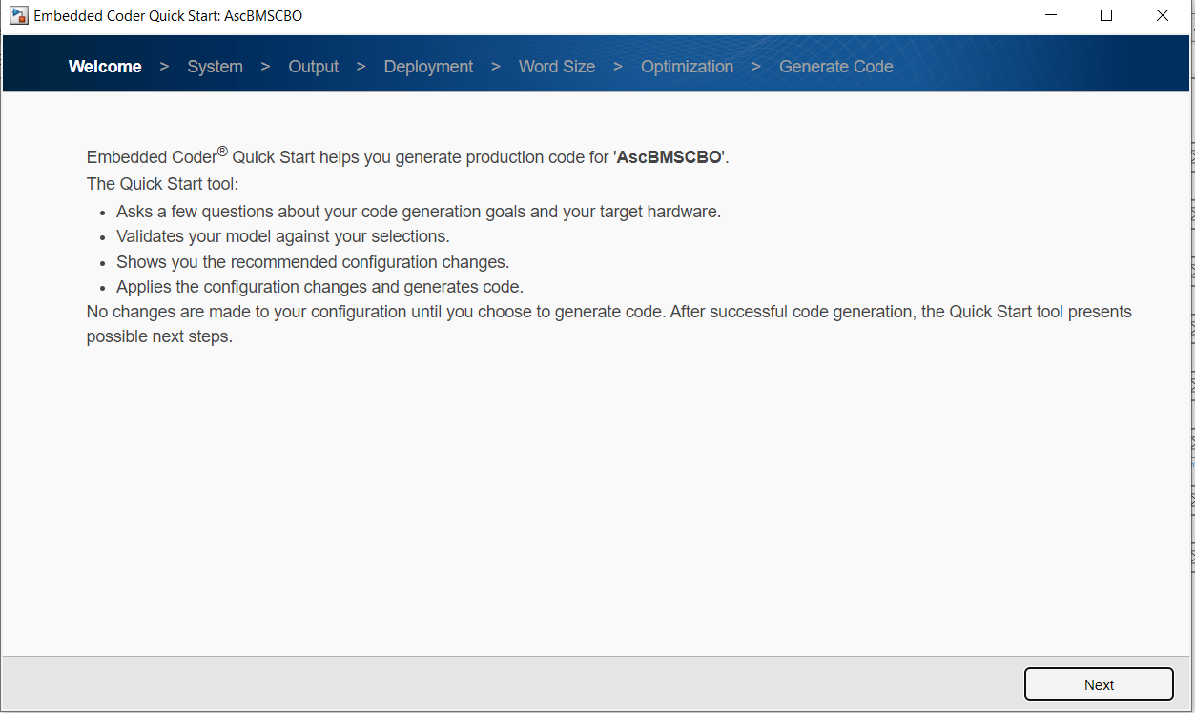
Autosar Adaptive modelling using MATLAB Simulink
Quick start
Once the code mapping and Autosar dictionary entries are done, open Quick start from the menu toolbar
Quick start can be then used to check the model parameters, set the target architecture and generate code
Click next

Slide 13
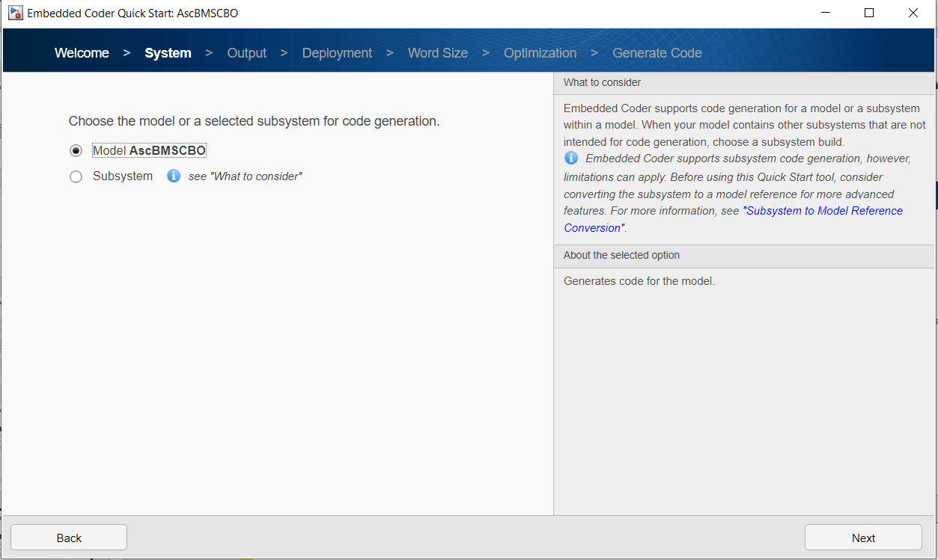
Autosar Adaptive modelling using MATLAB Simulink
Select model level for code generation
Select the level in which the code should be generated
Either select the entire model, or a particular subsystem
Click next after making the selection

Slide 14
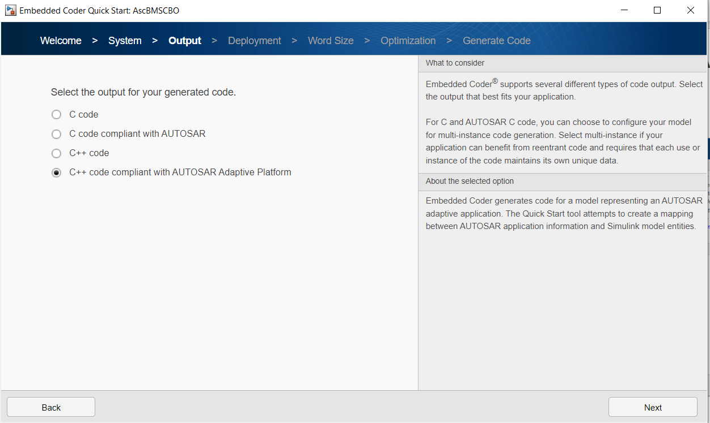
Autosar Adaptive modelling using MATLAB Simulink
Select the code type to be generated
Select the type of code to be generated
Options include a plain c code, c code complaint with Autosar (classic), plain C++ code and C++ code complaint with Autosar Adaptive Platform
Select C++ code complaint with Autosar Adaptive Platform option to generate code for Autosar Adaptive environment
Click next

Slide 15
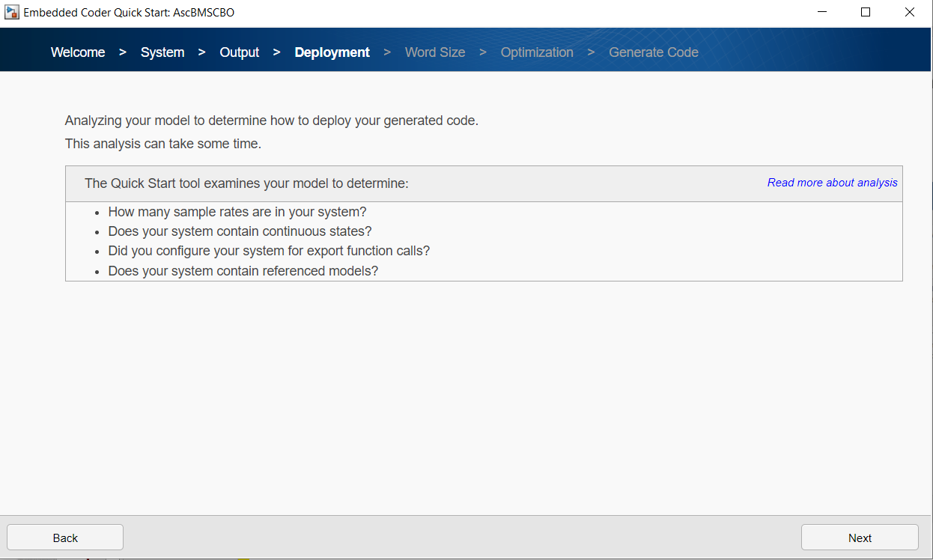
Autosar Adaptive modelling using MATLAB Simulink
Model analysis
Quick start will now analyze the model to determine how to deploy the generated code
Check are done to determine the sample rates, whether the system contains contiguous states, if there are configurations existing for export function calls and whether there are reference models contained
Click next to begin the analysis

Slide 16
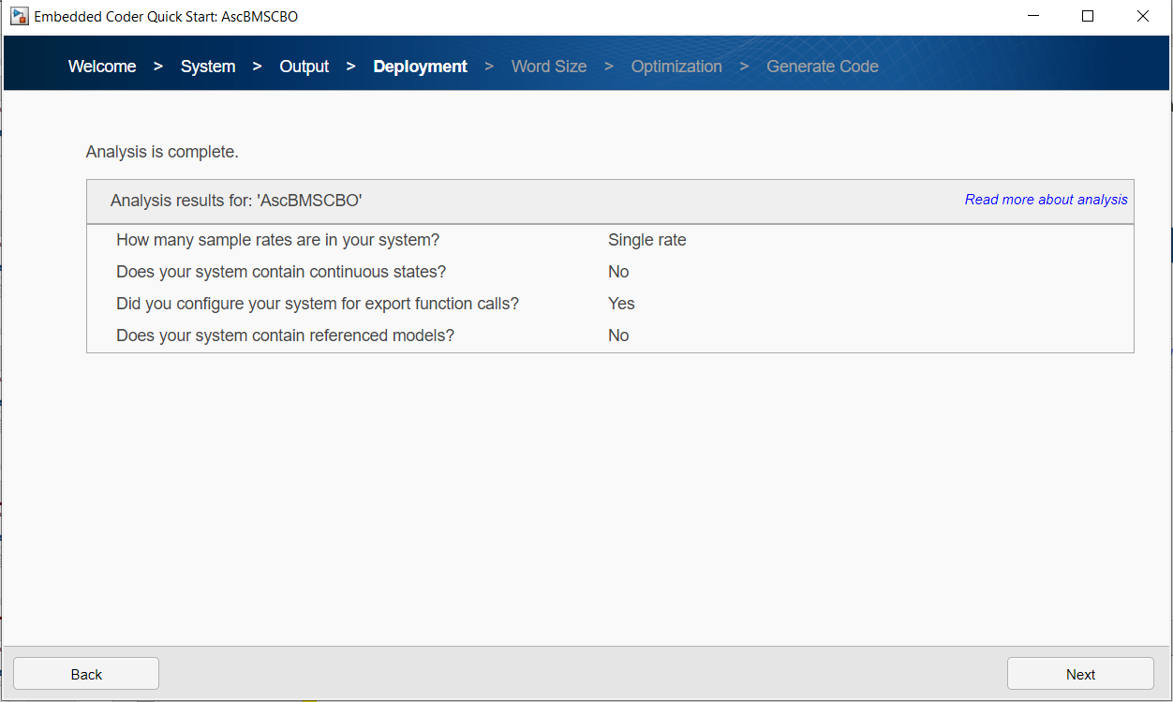
Autosar Adaptive modelling using MATLAB Simulink
Model analysis
One the analysis is started, it takes sometime for it to be completed
The analysis results are displayed next to the questions
Go back and make changes if the analysis results are not as expected
Click next to continue

Slide 17
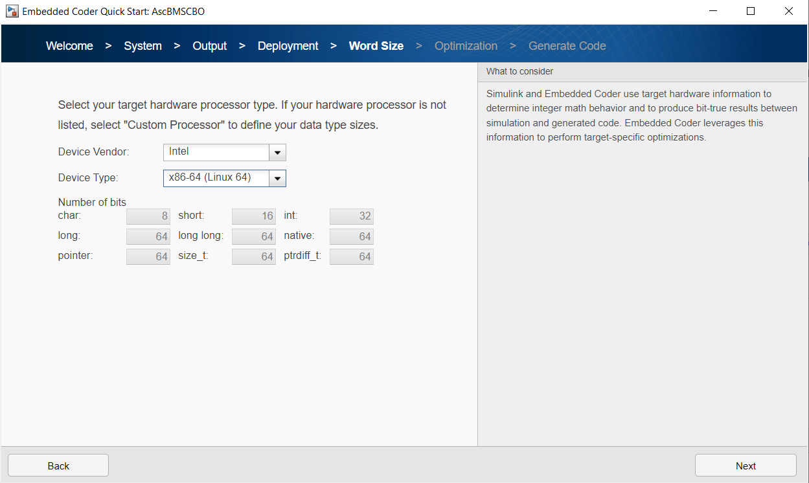
Autosar Adaptive modelling using MATLAB Simulink
Select the target processor
If the analysis results are acceptable, then proceed to select the target processor type from the drop down menu
If the target processor required is not listed, select customer processor and manually define the datatypes needed
Click next to continue

Slide 18
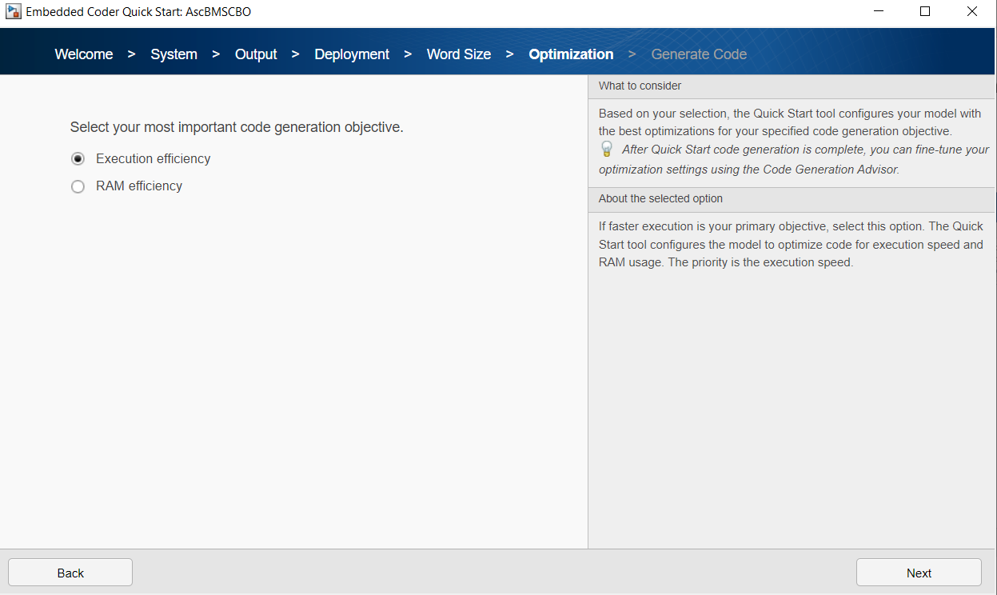
Autosar Adaptive modelling using MATLAB Simulink
Select the optimization options
After selectin the target processor type and datatypes, set the optimization options
Select either Execution efficiency or RAM efficiency, based on your requirement and preference
Click next to continue

Slide 19
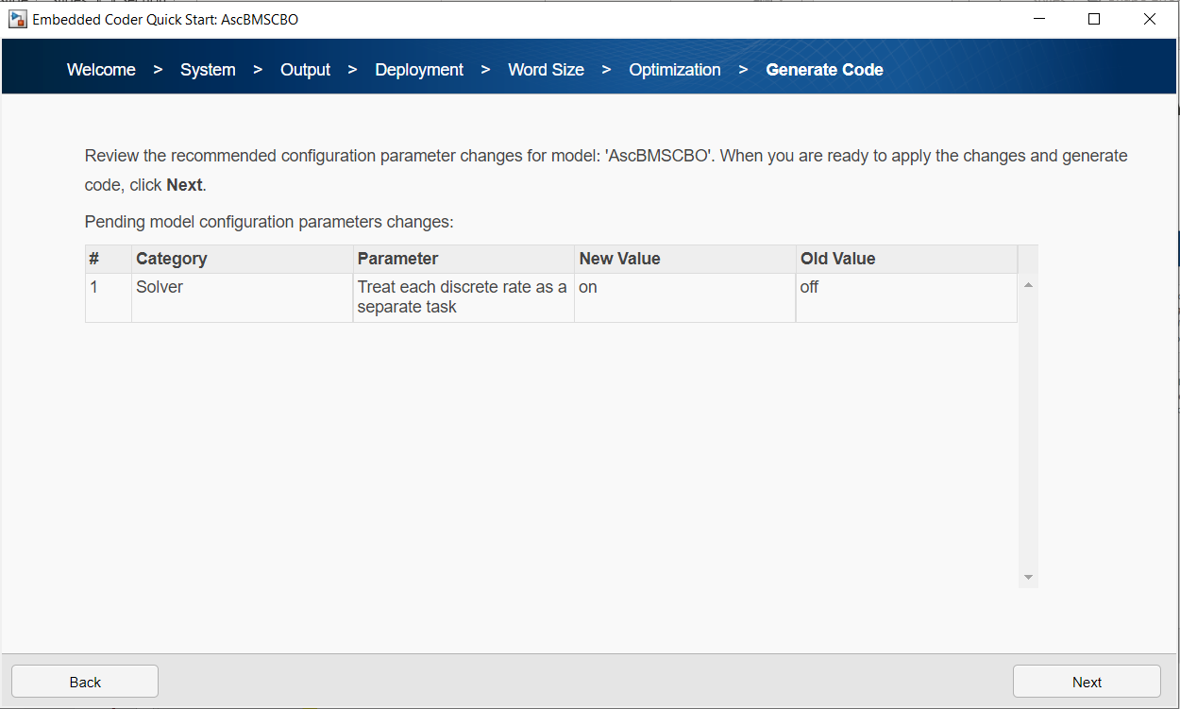
Autosar Adaptive modelling using MATLAB Simulink
Review the code generation configuration
Before generating code, quick start will list all the changes made compared to the previous settings
Go back and make changes if something is not as desired
Click next to generate code

Slide 20
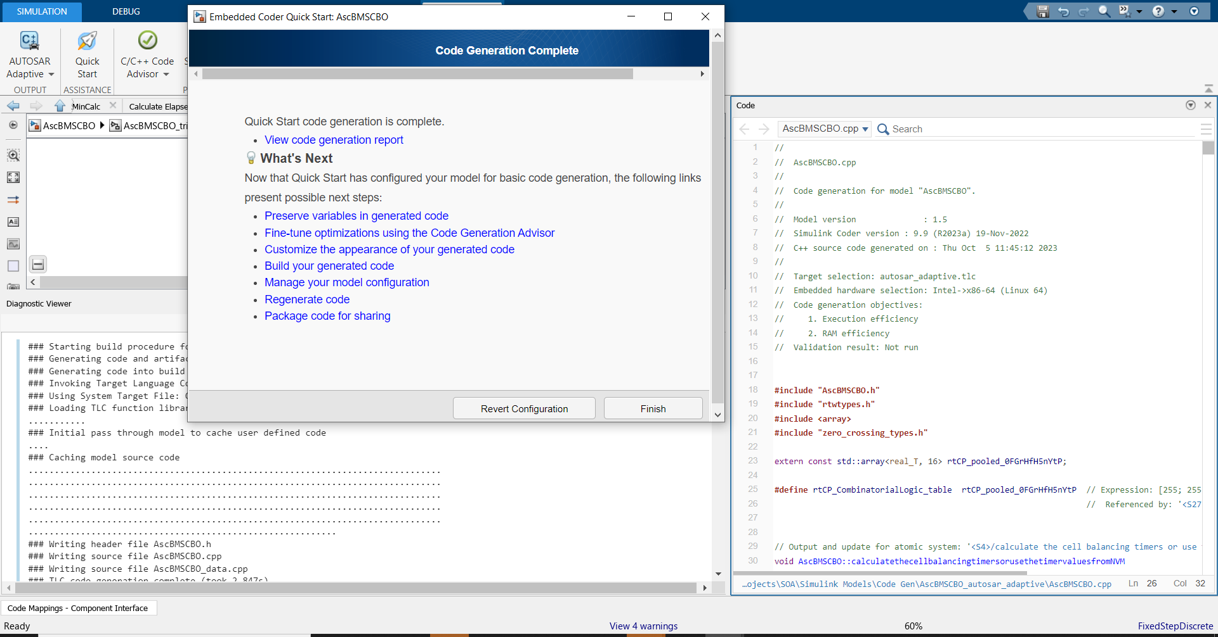
Autosar Adaptive modelling using MATLAB Simulink
Code generation
Code is generated if there are no errors in the model or settings
Code generation report is displayed
Further steps for deploying the code into the adaptive app can now be taken

Slide 21
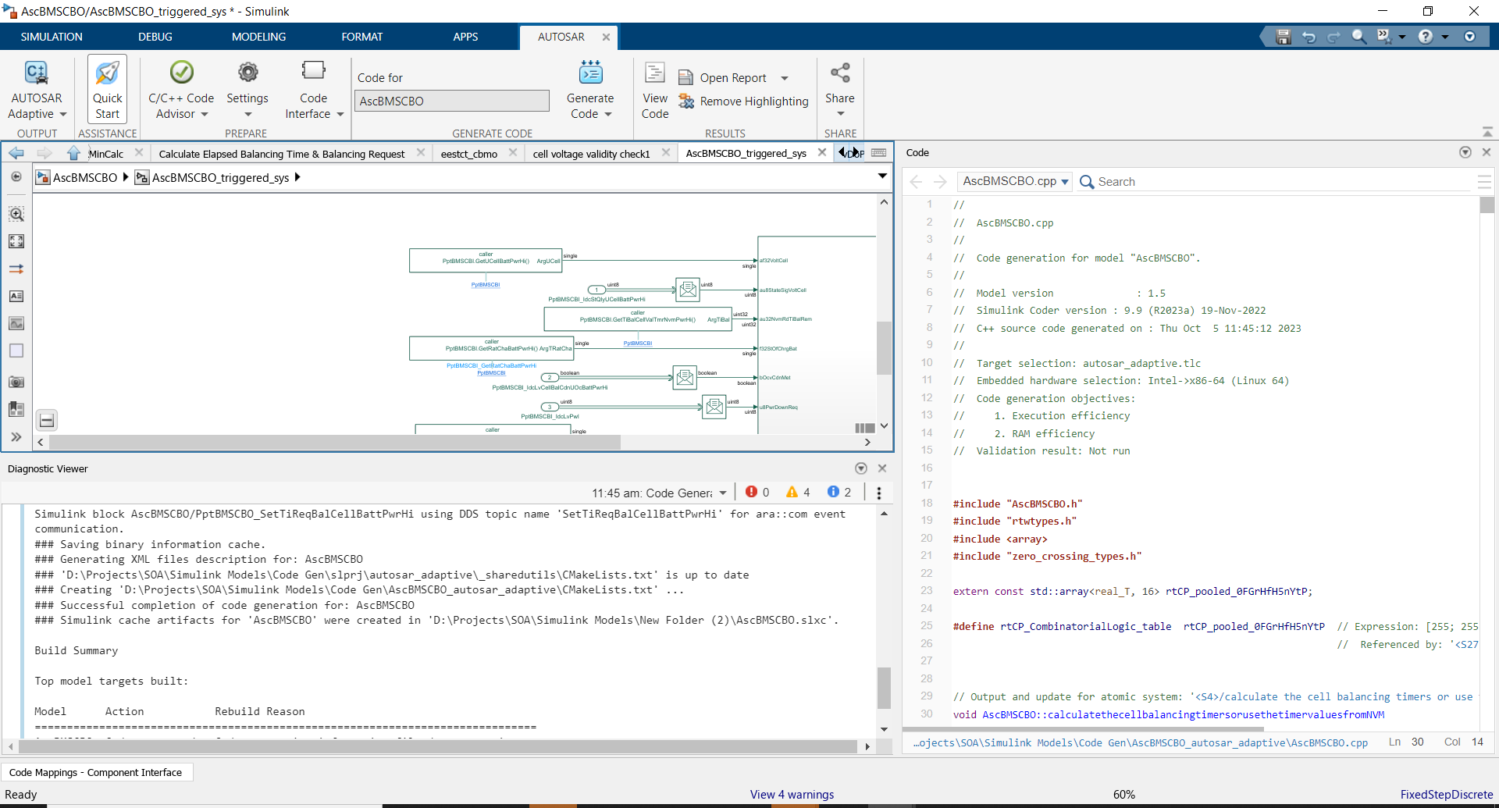
Autosar Adaptive modelling using MATLAB Simulink
Code generation
Generated code can be reviewed directly from Simulink window
Click dropdown to open different files generated

Slide 22
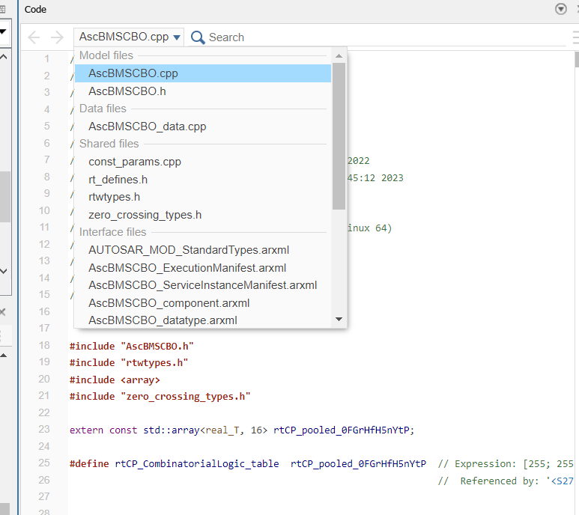
Autosar Adaptive modelling using MATLAB Simulink
Code generation
Click dropdown to open different files generated
Generated files include application cpp file, main cpp file, associated headers and arxml files required to deploy the app

Slide 23
Thank you.

